Slide 1
Storage, I/O, and Backups
Week 10

Slide 2
How the OS Talks to Devices (I/O)
I/O means input and output: anything going into or out of the computer
Device drivers translate between the OS and each kind of device
A device controller is the chip on the device, or the motherboard, that does the actual work
On Linux, devices show up as files in /dev, such as /dev/sda or /dev/nvme0n1
  lsblk lists drives, and lsusb lists USB devices
Notes:
Linux manual page, lsblk: https://man7.org/linux/man-pages/man8/lsblk.8.html
Linux manual page, lsusb: https://man7.org/linux/man-pages/man8/lsusb.8.html

Slide 3
Waiting for Devices
Devices are much slower than the CPU, so how does the CPU know when they are done?
Polling: the CPU keeps checking. Like checking your mailbox every five minutes
Interrupts: the device signals the CPU when it is done. Like a doorbell
DMA (direct memory access): the device copies data straight into memory without the CPU handling every byte. Like a delivery service that puts the packages away for you
Interrupts and DMA free the CPU to do other work while it waits

Slide 4
Buffering and Caching
A buffer holds data while it waits to be sent or used, like a waiting room
A cache keeps copies of recently used data in fast memory, so the next read is quicker
Write caching: the OS may say a file is saved before it's really on the drive
  That's why you eject a USB drive before pulling it out
  Windows calls this Safely Remove Hardware. On Linux, use Eject in the file manager, or the umount command
Notes:
Microsoft, Safely remove hardware in Windows: https://support.microsoft.com/en-us/windows/hardware/safely-remove-hardware-in-windows

Slide 5
Connecting Storage
SATA: the older connection for hard drives and some SSDs
NVMe: fast SSDs that connect straight to the PCI Express bus
USB: external drives, flash drives, and almost everything else. USB-C is the common plug today
Thunderbolt: a very fast external connection, common on Macs and high-end laptops
Network: NAS boxes and cloud storage connect over the network instead of a cable
Notes:
SATA-IO: https://sata-io.org/
NVM Express: https://nvmexpress.org/
USB-IF: https://www.usb.org/
Thunderbolt: https://www.thunderbolttechnology.net/

Slide 6
Permanent Storage Devices
Solid-state drives (SSDs): most common in new computers. No moving parts, fast and quiet
Hard disk drives (HDDs): spinning disks. Cheaper per terabyte, so used in servers, NAS boxes, and backup drives
Flash memory: USB drives, SD and microSD cards
Cloud storage: OneDrive, Google Drive, iCloud, Dropbox (someone else's drives)
Magnetic tape: still used by data centers for cheap long-term backup and archives
Historical note: CDs, DVDs, and Blu-ray. Most laptops no longer have a disc drive
  Still worth knowing because older archives, software, and some game consoles still use discs
Notes:
IBM, What is a solid-state drive?: https://www.ibm.com/think/topics/solid-state-drives
LTO tape: https://www.lto.org/

Slide 7
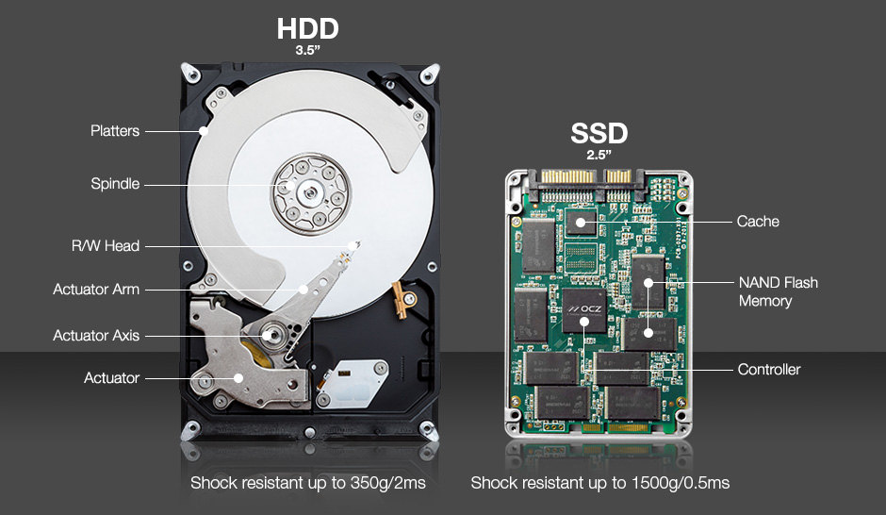
How Hard Drives and SSDs Work
HDD: spinning platters and a read/write head on a moving arm
  Seek time: moving the arm to the right track
  Rotational latency: waiting for the disk to spin to the right spot
SSD: flash memory chips and a controller, with no moving parts
  Much faster, quieter, and harder to break if dropped
Notes:
IBM, What is a solid-state drive?: https://www.ibm.com/think/topics/solid-state-drives

Slide 8
SSDs and Free Space
TRIM: the OS tells the SSD which blocks are free, so it can clean them up ahead of time
Defragmenting moves file pieces back together. It helps hard drives
SSDs should not be defragmented. Windows and Linux run TRIM on them instead
The SSD spreads writes evenly (wear leveling), because each flash cell can only be written so many times
Notes:
ArchWiki, Solid state drive: https://wiki.archlinux.org/title/Solid_state_drive

Slide 9
Disk Scheduling
Historical note: hard drives were the slowest part of a computer, so the OS reordered requests to cut down on arm movement
  First come, first served (FCFS): simple, but the arm jumps all over
  Shortest seek time first (SSTF): go to the closest request next
  SCAN, the elevator algorithm: sweep across the disk one way, then back
Still worth knowing because hard drives are still in servers and NAS boxes, and the elevator idea shows up all over computing
Today, Linux picks an I/O scheduler for each drive. Fast NVMe SSDs often use none, and hard drives often use mq-deadline or BFQ
Notes:
Linux kernel documentation, Block layer (I/O schedulers): https://docs.kernel.org/block/index.html
BFQ: https://docs.kernel.org/block/bfq-iosched.html

Slide 10
Partition Tables: GPT and MBR
A partition table is the map of where each partition starts and ends
GPT (GUID Partition Table): the modern standard, used with UEFI
  Handles huge drives, and up to 128 partitions on Windows
Historical note: MBR (Master Boot Record) was the standard with BIOS
  Limited to drives of about 2 TB and 4 main partitions
  Still worth knowing because older computers and some USB drives still use it
Notes:
Microsoft, Windows and GPT FAQ: https://learn.microsoft.com/en-us/windows-hardware/manufacture/desktop/windows-and-gpt-faq

Slide 11
RAID
RAID (redundant array of independent disks) combines several drives so they act as one
RAID 0 (striping): splits data across drives. Fast, but if one drive dies, everything is lost
RAID 1 (mirroring): two drives with identical copies. Survives one dead drive
RAID 5: data plus parity spread over 3 or more drives. Survives one dead drive
RAID 6: like RAID 5 with double parity. Survives two dead drives
RAID 10: mirroring plus striping. Fast and safe, but half the space goes to copies
Notes:
Linux kernel documentation, RAID arrays: https://www.kernel.org/doc/html/latest/admin-guide/md.html

Slide 12
RAID in Practice
Parity: extra data, worked out with math, that can rebuild a dead drive's data
Hardware RAID: a controller card does the work
Software RAID: the OS does the work. Linux uses mdadm, and ZFS and Btrfs have their own RAID
RAID is not a backup
  It survives a dead drive, but not deletion, ransomware, fire, or theft
Notes:
Linux manual page, mdadm: https://man7.org/linux/man-pages/man8/mdadm.8.html

Slide 13
Network and Cloud Storage
NAS (network-attached storage): a box of drives that shares files over the network, for a home or office
SAN (storage area network): a separate fast network that gives servers raw drive space, used by large companies
Cloud storage: rent space from providers like Microsoft, Google, Amazon, or Apple
  Object storage, such as Amazon S3, holds huge numbers of files for websites and apps
Notes:
IBM, What is network attached storage?: https://www.ibm.com/think/topics/network-attached-storage
IBM, What is a storage area network?: https://www.ibm.com/think/topics/storage-area-network
AWS, What is object storage?: https://aws.amazon.com/what-is/object-storage/

Slide 14
Data Integrity Protection
Computer systems often store critical information:
  Inventories, financial records, personal information
Crashes, power outages, natural disasters, ransomware, and simple mistakes can destroy it
The results can be catastrophic
Systems should be fault tolerant:
  Plan for disasters, and provide ways to recover from them

Slide 15
Backup and Recovery
Backup: store extra copies of information
Recovery: restore data after a failure
Physical safeguards, such as locks and fire alarms, are the lowest level of protection
Full backups copy everything
Incremental backups copy only what changed since the last backup of any kind
Differential backups copy everything that changed since the last full backup

Slide 16
Types of Backups
Physical backups: copy the device bit by bit, such as a full disk image
Logical backups: copy the files and folder structure
  Linux tools: tar and rsync
Snapshots: save the file system at a moment in time, so you can roll back
  Linux: Timeshift, and Btrfs or ZFS snapshots
  Windows: File History. macOS: Time Machine
Notes:
Timeshift: https://github.com/linuxmint/timeshift
Microsoft, Backup and restore with File History: https://support.microsoft.com/en-us/windows/experience/backup-recovery/backup-and-restore-with-file-history
Apple, Back up your Mac with Time Machine: https://support.apple.com/en-us/104984

Slide 17
The 3-2-1 Backup Rule
Keep 3 copies of your data
On 2 different types of storage
With 1 copy somewhere else (offsite or in the cloud)
Keep at least one backup offline: ransomware hunts for backups too
Test that you can actually restore your backups
Watch out:
  RAID is not a backup. It survives a dead drive, not deletion or ransomware
  Cloud sync is not a backup. Delete a synced file and it's deleted everywhere
Notes:
CISA #StopRansomware Guide (offline, encrypted backups; test restores): https://www.cisa.gov/stopransomware/ransomware-guide

Slide 18
Disaster Recovery
Plan ahead: what happens if the building floods, or ransomware hits?
Recovery point objective (RPO): how much data can you afford to lose? An hour? A day?
Recovery time objective (RTO): how long can you be down before it really hurts?
The answers decide how often you back up, and how fast you need to restore
Ransomware and backups come up again in Week 12, Security and Protection
Notes:
NIST SP 800-34 Rev. 1, Contingency Planning Guide (defines RPO and RTO): https://csrc.nist.gov/pubs/sp/800/34/r1/upd1/final
IBM, What is disaster recovery?: https://www.ibm.com/think/topics/disaster-recovery
CISA #StopRansomware Guide: https://www.cisa.gov/stopransomware/ransomware-guide

